Slide 1
ANALYZING THE OSCARS
BootCamp Project 1
A production starring
Produced and Directed by
Cassandra Gormsen
Geoffrey Flynn
Tyler Hannan
Jennifer Gabrysiak.
Matplotlib
Jupyter Notebook
Pandas
Special Appearances by
https://www.kaggle.com/unanimad/the-oscar-award
http://www.omdbapi.com/apikey.aspx
https://www.statista.com/statistics/1072778/highest-grossing-movie-annually-historical/
https://www.openintro.org/data/index.php?data=oscars
MOVIES

Slide 2
OSCAR Fun
Bootcamp Project 1
BY THE END OF THIS EVENT, YOU WILL KNOW THE ANSWERS TO THE FOLLOWNG QUESTIONS:
Does winning an Oscar mean better box office?
Does the month of the movies release have any correlation to the films winning Best Picture?
Do critics reviews impact the winners more than audience review?
Is there any correlation between the ages of the nominees and the winners throughout the years of the Oscars?
Of the best director Oscars nominees, what are the differences in age and gender of the candidates?

Slide 3
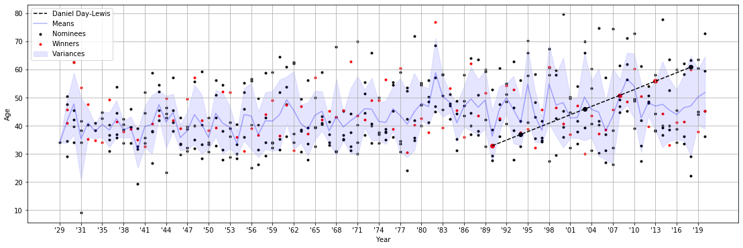
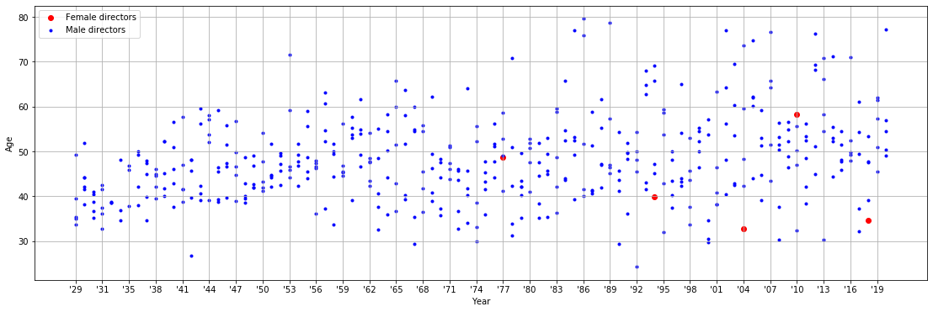
Question 1: Is there any correlation between the ages of the nominees and the winners throughout the years of the Oscars?
Question 2: Of the best director Oscars nominees, what are the differences in age and gender of the candidates?

Slide 4
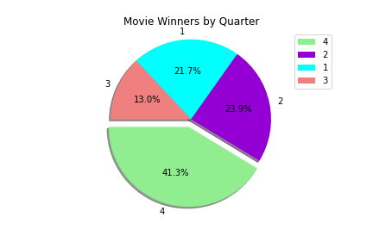
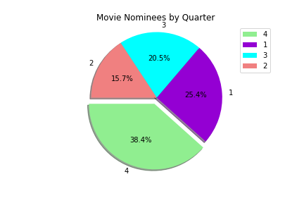
Does the month and quarter of the movies release have any correlation to the films winning Best Picture?
The answer is a resounding YES! 38.4% of nominees and 41.3% of the winners come from the fourth quarter. Summer movies only make up 20.5% of the nominees and have won only 13% of the award
Winners by Quarter vs Nominees by Quarter

Slide 5
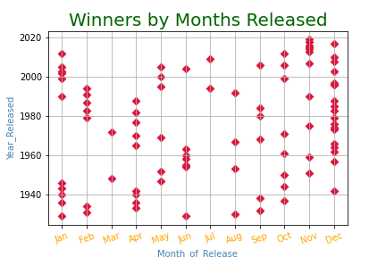
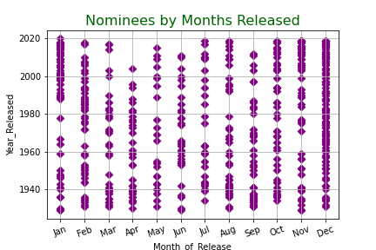
When the months were reviewed, December is a clear leader, although in recent years movies released in November have had more Best Picture Oscars.

Slide 6



How well do movies that win the Best Picture Oscar do at the box office compared to other movies?

Slide 7
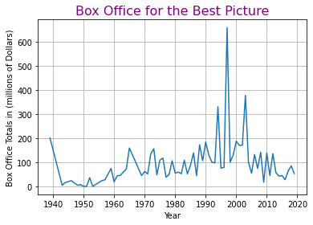
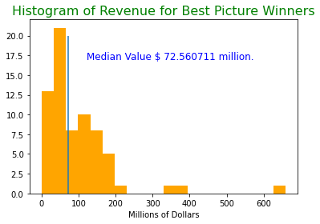
Box Office Revenue for the winner of Best Picture each year

Slide 8
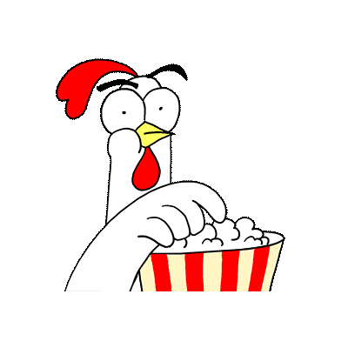
Top 15 Highest Grossing Movies of all Time
rank | Title | Total Boxoffice | year
1 | Avatar | $2,847,246,203 | 2009
2 | Avengers: Endgame | $2,797,501,328 | 2019
3 | Titanic | $2,201,647,264 | 1997
4 | Star Wars: Episode VII - The Force Awakens | $2,068,455,677 | 2015
5 | Avengers: Infinity War | $2,048,359,754 | 2018
6 | Jurassic World | $1,670,516,444 | 2015
7 | The Lion King | $1,657,870,986 | 2019
8 | The Avengers | $1,518,815,515 | 2012
9 | Furious 7 | $1,515,255,622 | 2015
10 | Frozen II | $1,450,026,933 | 2019
11 | Avengers: Age of Ultron | $1,402,809,540 | 2015
12 | Black Panther | $1,347,597,973 | 2018
13 | Harry Potter and the Deathly Hallows: Part 2 | $1,342,321,665 | 2011
14 | Star Wars: Episode VIII - The Last Jedi | $1,332,698,830 | 2017
15 | Jurassic World: Fallen Kingdom | $1,310,464,680 | 2018

Slide 9
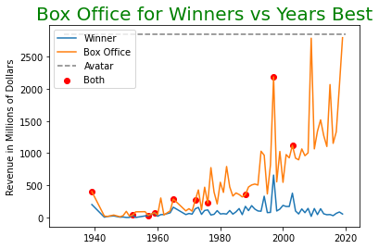
How did the Best Picture compare to the other movies that year.

Slide 10
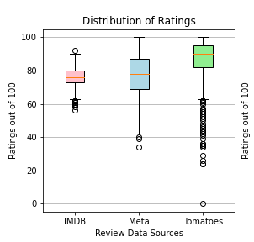
Are the Oscar winners rated higher by critics than the average viewer?
The lower quartile of IMDB ratings is: 73.0
The upper quartile of IMDB ratings is: 80.0
The interquartile range of IMDB ratings is: 7.0
The median of IMDB ratings is: 76.0
The average IMDB rating is: 75.84
Values below 62.5 could be outliers.
Values above 90.5 could be outliers.
The lower quartile of MetaScore ratings is: 69.0
The upper quartile of MetaScore ratings is: 87.0
The interquartile range of MetaScore ratings is: 18.0
The median of MetaScore ratings is: 78.0
The average MetaScore rating is: 75.84
Values below 42.0 could be outliers.
Values above 114.0 could be outliers.
The lower quartile of RottenTomatoes ratings is: 82.0
The upper quartile of RottenTomatoes ratings is: 95.0
The interquartile range of RottenTomatoes ratings is: 13.0
The median of RottenTomatoes ratings is: 90.0
The average RottenTomatoes rating is: 75.84
Values below 62.5 could be outliers.
Values above 114.5 could be outliers.

Slide 11
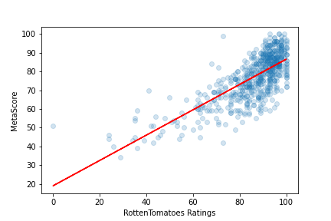
Are the Oscar winners rated higher by critics than the average viewer?

